Slide 1

After a few weeks of intensive work the pathway was nearing completion and Benandonner’s home, Fingal’s Cave was only a stride away.
Fionn, exhausted, lay down to sleep.

Slide 2
At dawn break the next morning, Fionn’s wife, Oonagh woke to the thundering footsteps of Benandonner striding towards their home.

Slide 3
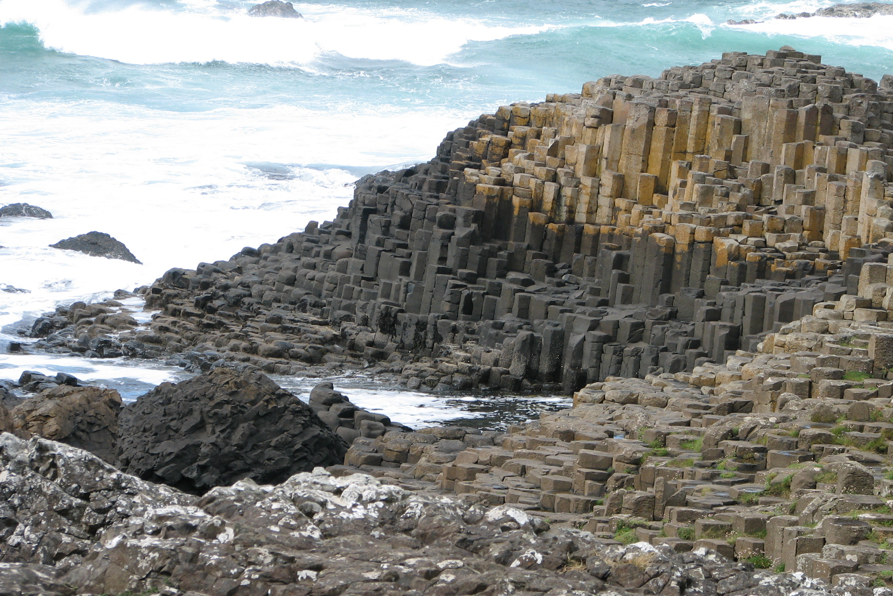

Slide 4
Quickly realising the still resting Fionn would be no match for Benandonner she woke Fionn and dressed him in one of her nightgowns and placing a bonnet on his head she urged him to pretend to sleep.

